Slide 1




EXECUTIVE SUMMARY
Ustacky Data Science Microdegree Program
Analysis of Sales Record Data - Company XYZ

Slide 2
INTRODUCTION
Problem Statement
Answers and insights are extracted from the recorded sales information of this company’s supermarket chain across the country; Abuja, Lagos and Port Harcout for 3 months (Between January and March. 2019)

Slide 3
PURPOSE STATEMENT
This analysis is to help this company understand sales trends and determine its growth, as the rise of supermarkets competition is seen to increase.

Slide 4

Results from this analysis can be used by the company to make better decisions and help position them at an advantage against their competitors.

Slide 5
PROJECT SUMMARY
Question answered in this project includes:
Which Gender has the highest purchase record ?
Which Product Line has the highest Purchase record ?
Which Customer type has the highest purchase record ?
What is the most frequent Payment method ?
Which City has the highest sales record ?
Which City has the highest total Gross Income ?
Which Branch or City has the highest customer rating?
What are the Unique Hours of sales and the most frequent Hours of Sales.

Slide 6
Which Product Line produces the highest Gross income ?
What is the relationship between Hour of sale and Gross income ?
What is the relationship between Gender and Unit Price of stuff bought?
What is the relationship between Unit Price and the Quantity bought ?
What is the relationship between Gender and Quantity of stuff bought ?

Slide 7
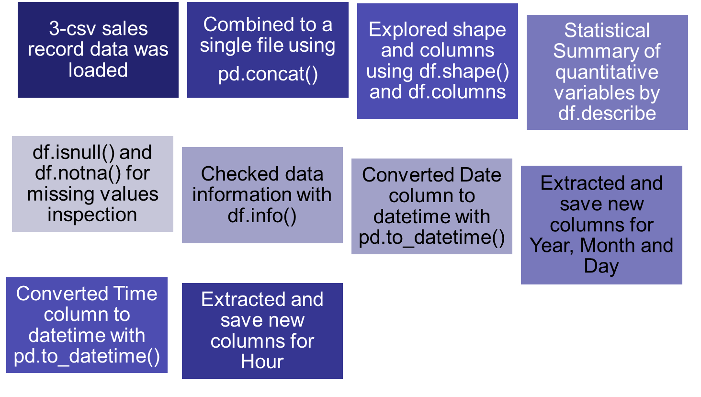
DATA ANALYSIS OVERVIEW

Slide 8
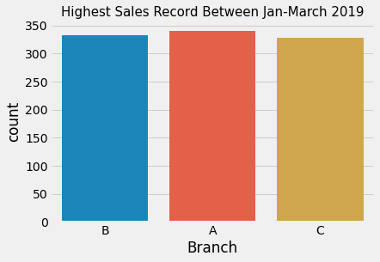
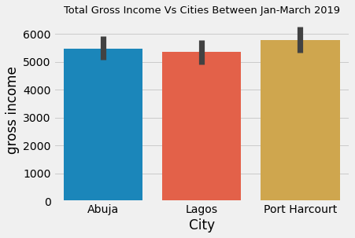
VISUALISATIONS & INSIGHTS
1. The sales in branch A is a bit higher but there is no much significant difference across the three branches.
2. Port Harcout records slightly higher gross income than the rest

Slide 9
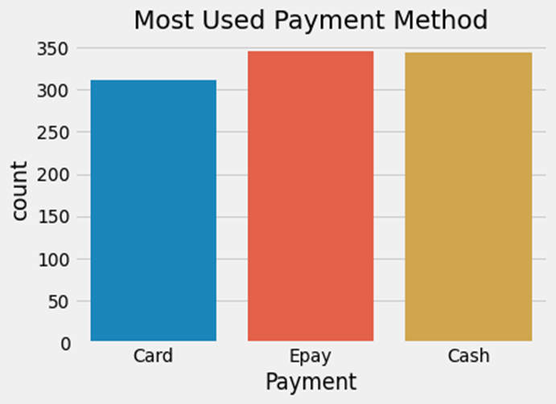
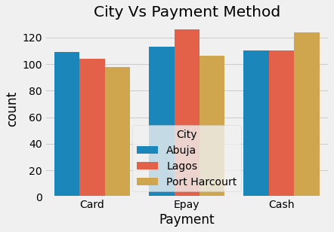
Epay is slightly the most used payment methods followed closely by Cash. Card is the least used
2. Cash payment is the most frequent payment method in Port Harcourt
E-pay is the most frequent payment method in Lagos
Card Payment is the most frequent payment method in Abuja

Slide 10
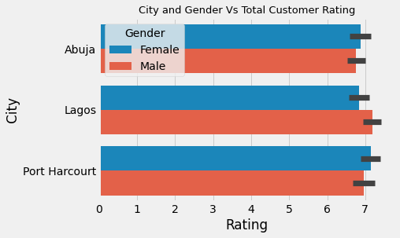
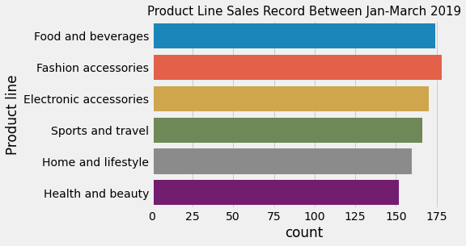
Lagos has the highest rating generally and also by Males while Port Harcourt has the highest rating by Females
Fashion and accessories records more sales between January to March

Slide 11
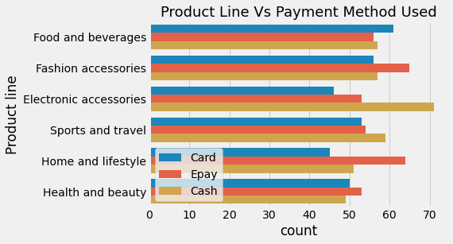
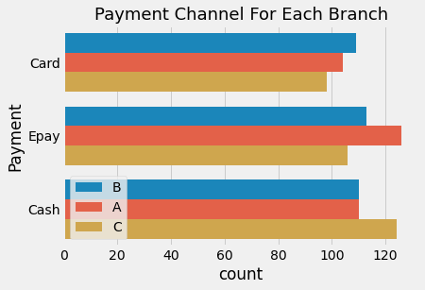
Most of the Payment of Electronics is by cash but its by Epay in Fashion and Home appliances

Slide 12
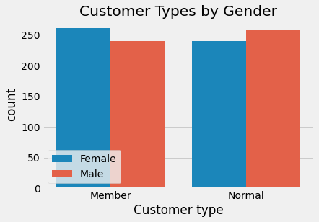
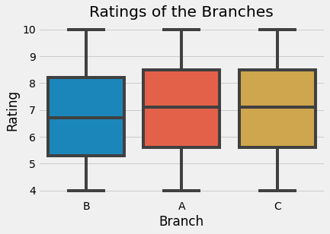
1. There are more Female customers with Membership while there are more Male customers without Membership
2. Abuja has the lowest rating by customers and Port Harcourt has the highest mean customer rating

Slide 13
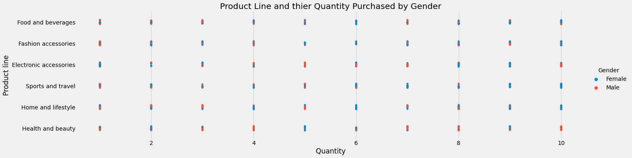
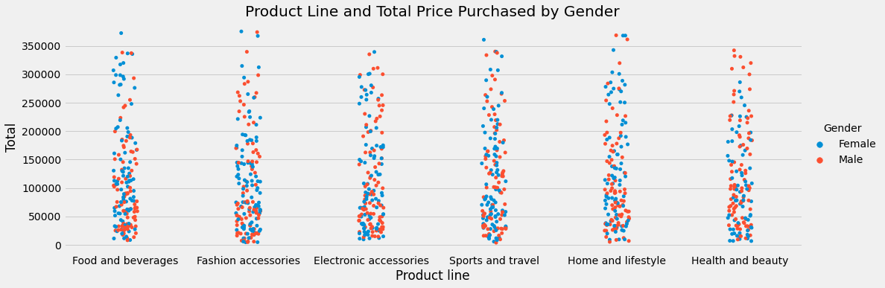

Slide 14
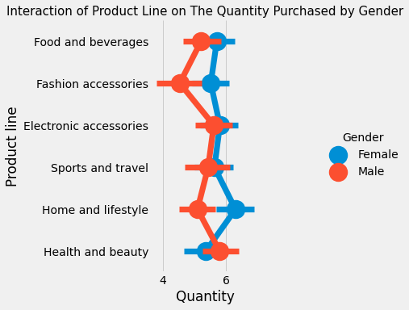
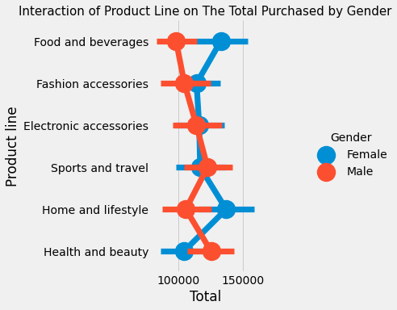

Slide 15
From the charts in the previous pages we observed that;
Many Females purchased in bulk quantity the following
Food & beverages, Sport & Travels and Home & Lifestyle
Male purchased in bulk quantity the following Electronic accessories and Health and Beauty
The Female purchased more quantity of goods with lower Unit price.
The Male purchased more quantity of goods with higher unit prices.
Females usually spends much more on Food & Beverages, Fashion accessories and also Home & Lifestyle.
Males money mostly goes to Health & Beauty

Slide 16
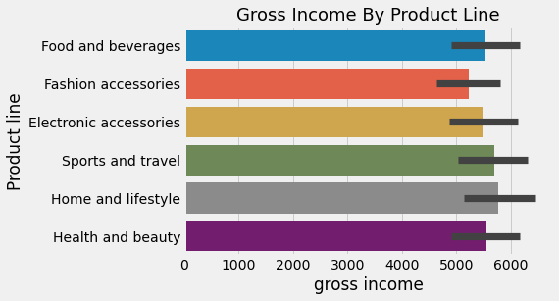
Home & Lifestyle contributed the most to the Gross income of the Company followed by Sport & Travel.

Slide 17
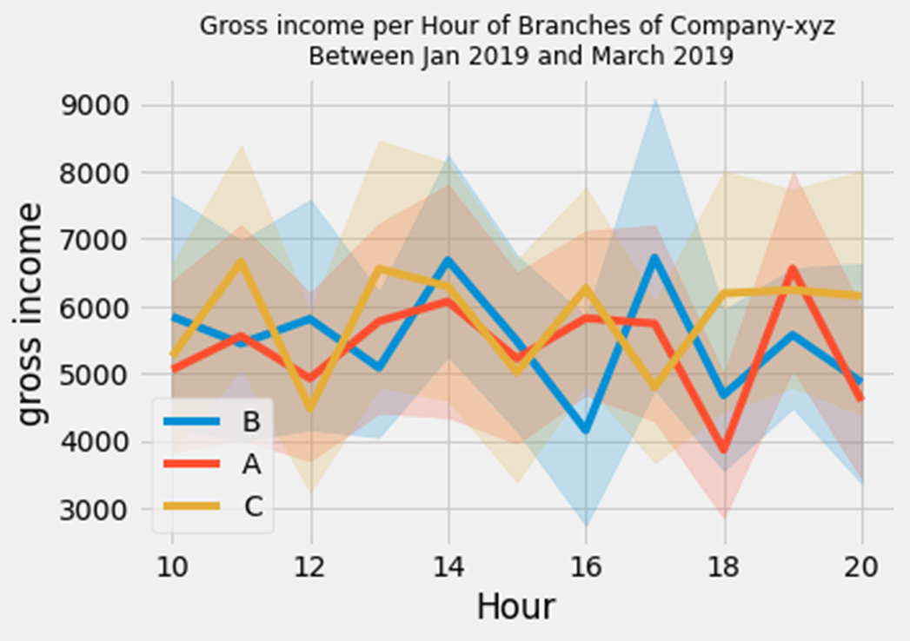
The Gross income of Port Harcourt has multiple peaks at 11, 13, 16, 18-20
The Gross income of Lagos is fairly constant and maximum at 19H
The Gross income of Abuja is maximum at 14H and 17H

Slide 18
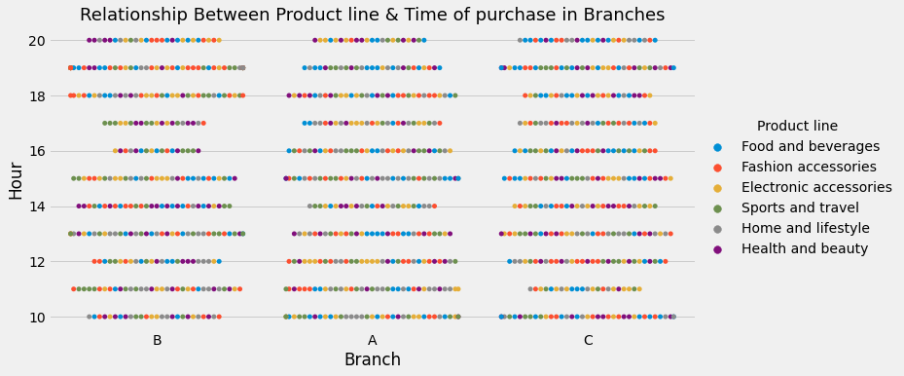
Sales surges in Abuja between 11-13H for Sport & Travel and 18H Home & Lifestyle
Sales surges in Lagos between 10H and 11H for Home & Lifestyle
Sales surges in Port Harcourt 10H for Home & Lifestyle, 12H for Sport & Travel and 19H for Fashion accessories.

Slide 19
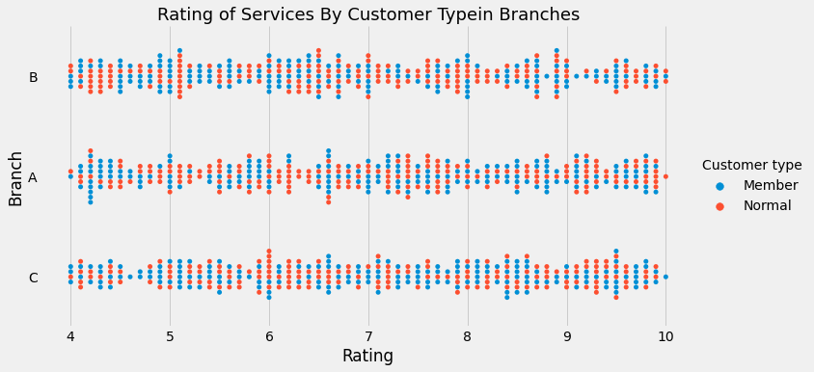
Rating of Services By Customer Type in Branches

Slide 20
SUMMARY AND CONCLUSION
There are generally more Female customers than Male customers
Port Harcourt with the highest Female customers recorded the highest Gross Income for company XYZ
Gender has a significant effect on the Product line sold in this company
The Product line that contributed the most to the Gross income are Home & lifestyle Products (Gender-based).
Port Harcourt with the highest mean rating has the highest gross income.
Abuja with the least mean rating has the least gross income.
Epay is the most used method of payment

Slide 21
RECOMMENDATION
Strategy should be put in place to revamp and improve costumer satisfaction in Abuja branch to increase its rating and sales.
Special treatment should be given those hours were sales surges by adding more staff to attends to costumers
Significant attention should be paid to favourite costumers and also appeals to more normal costumers especially Males
Hit the strategy reset button: Do away with traditional ways of operating and realign strategy with the changing market dynamics. In addition to technology, also induce creativity and sensitivity to address business problems in the digital landscape

Slide 22
THANK YOU.

